Slide 1
Unicast and Multicast Routing

Slide 2
Topics of Discussion
In this session we will learn the following
Routing Concept on Internet
Distance Vector and Link State Protocols
RIP and OSPF protocols
Unicast routing
Multicast routing

Slide 3
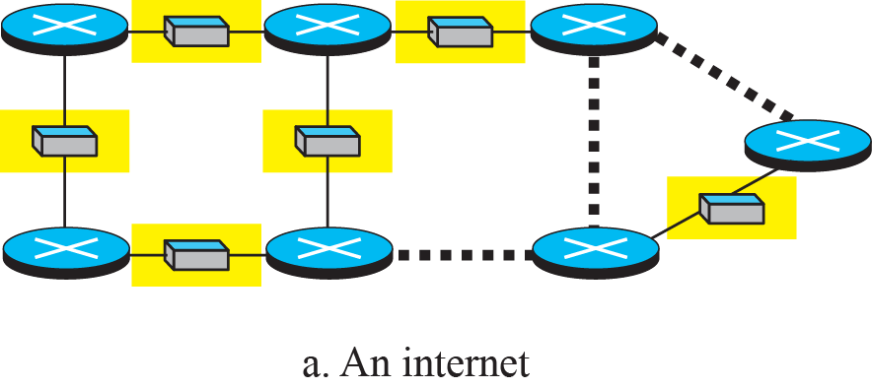
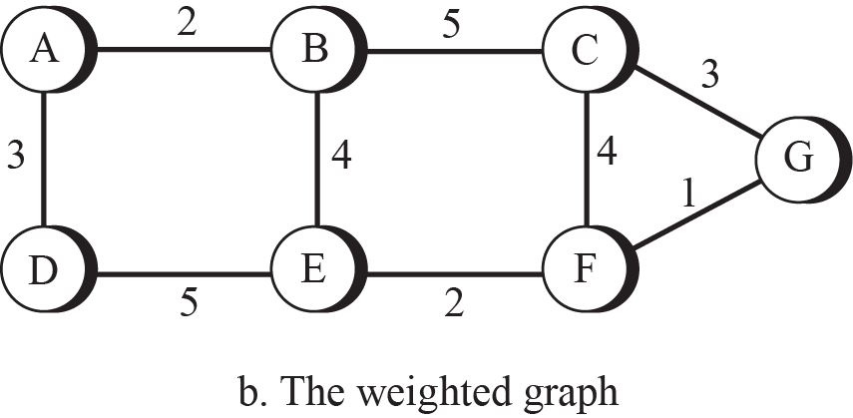
Routing Concept on Internet
An internet is modeled as a weighted graph.
One of the ways to interpret the best route from the source router to the destination router is to find the least cost between the two.
In other words, the source router chooses a route to the destination router in such a way that the total cost for the route is the least cost among all possible routes.

Slide 4
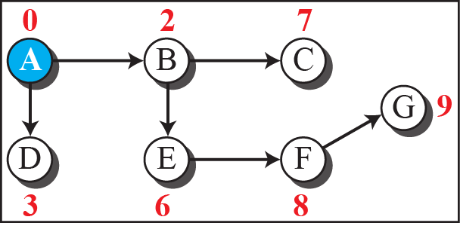
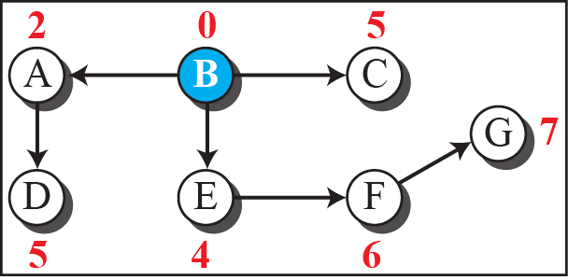
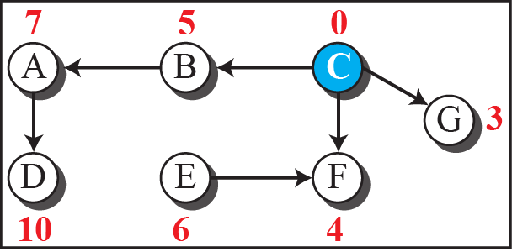
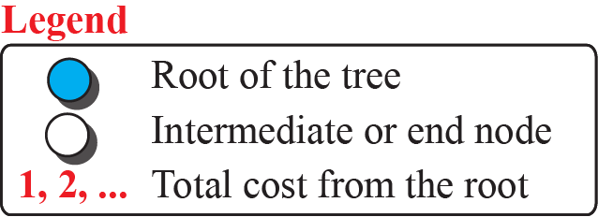
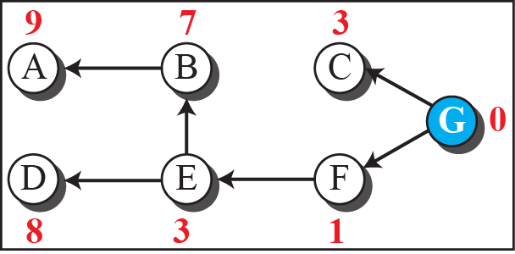
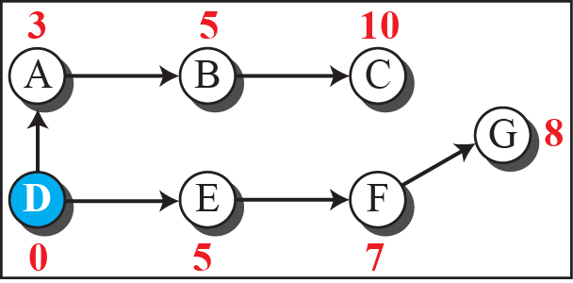
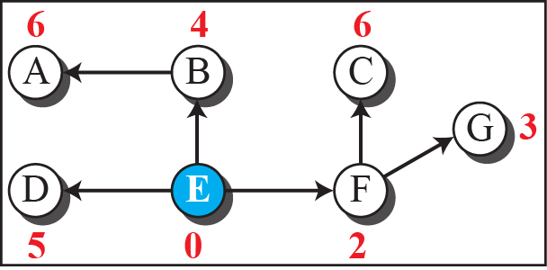
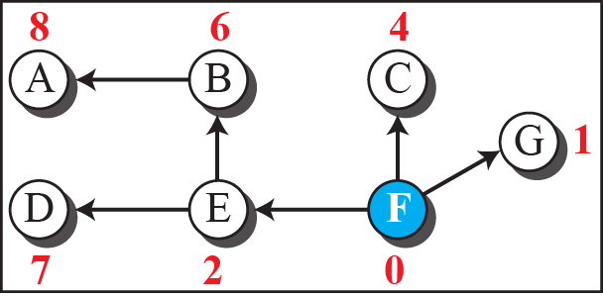
Figure 1: Least-cost trees for nodes in the internet

Slide 5
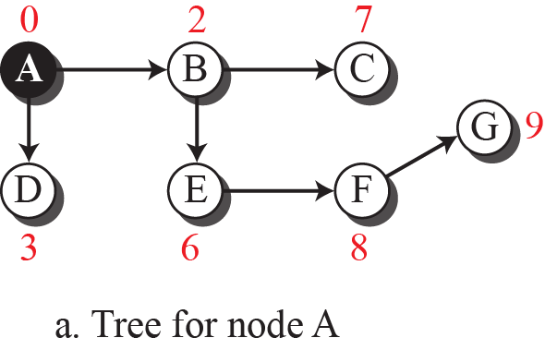
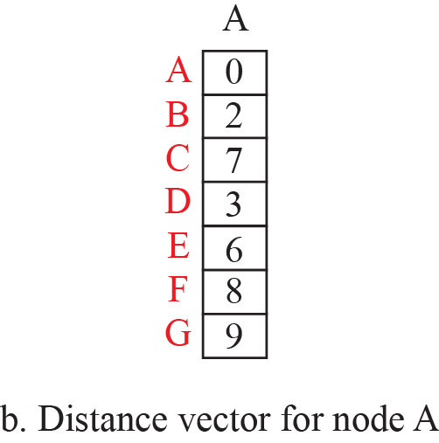
Routing Algorithms
The routing methods differs in the way they interpret the least cost and the way they create the least-cost tree for each node. In this section, we discuss the common algorithms.
Distance Vector Routing
The distance-vector (DV) routing uses weights to find the best route.
In distance-vector routing, the first thing each node creates is its own least-cost tree with the rudimentary information it has about its immediate neighbors.
The incomplete trees are exchanged between immediate neighbors to make the trees more and more complete and to represent the whole internet.

Slide 6
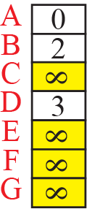
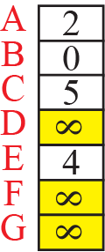
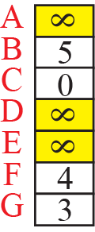
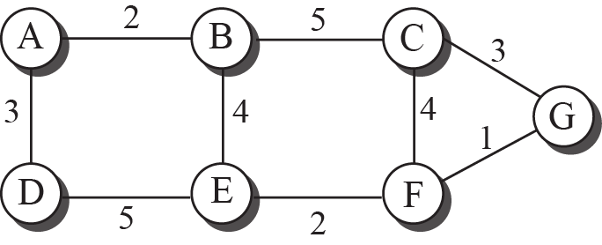
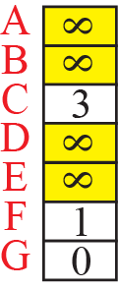
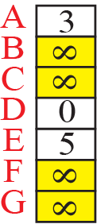
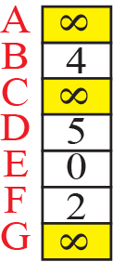
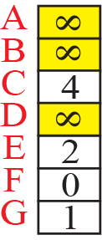
Example 1: Distance vector for an Internet, Step 1

Slide 7
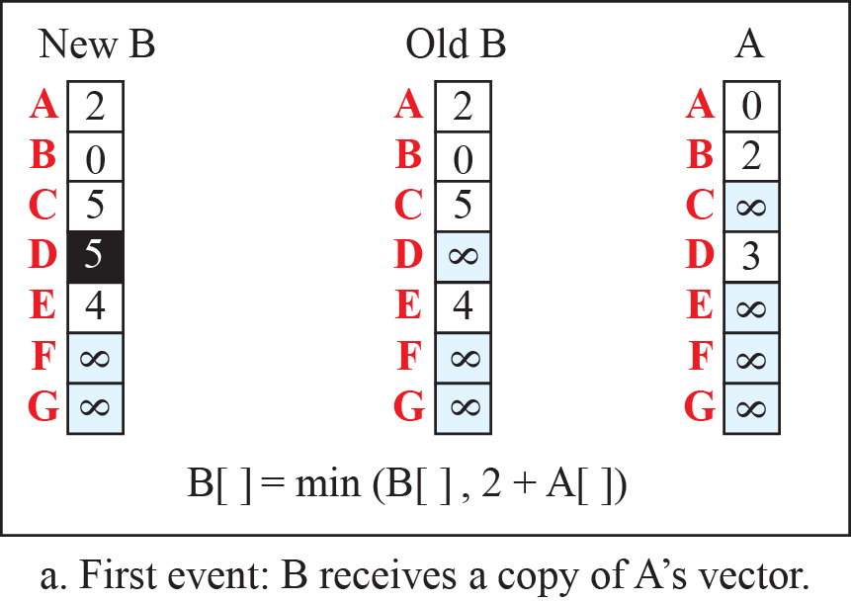
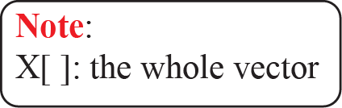
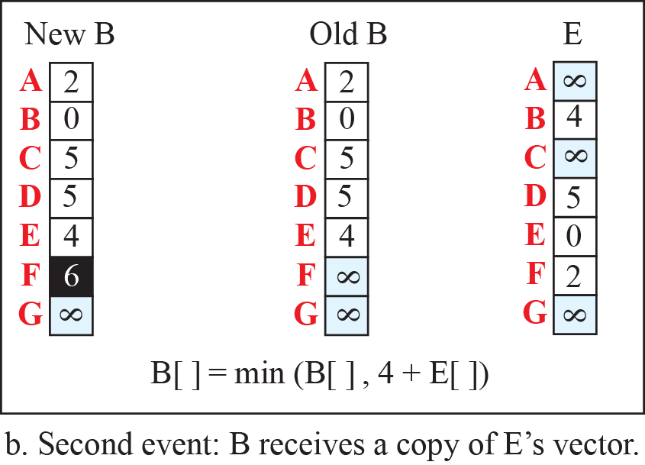
Example 1.1: Updating Distance vectors, Step 2

Slide 8
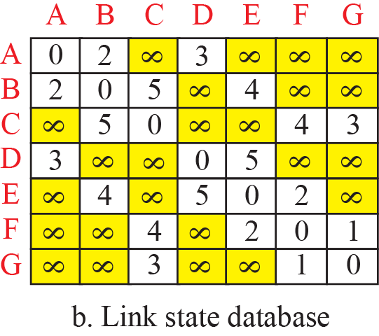
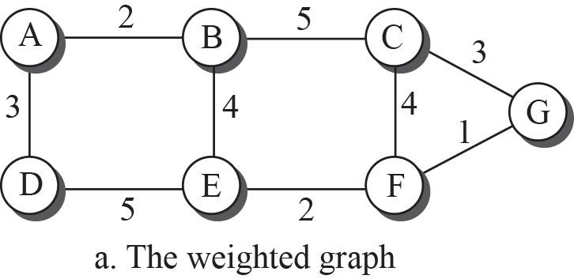
Link State Routing
This method uses the term link-state to define the characteristic of a link (an edge) that represents a network in the internet.
In this algorithm the cost associated with an edge defines the state of the link.
Links with lower costs are preferred to links with higher costs; if the cost of a link is infinity, it means that the link does not exist or has been broken.

Slide 9
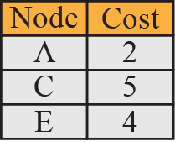
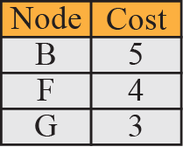
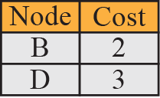
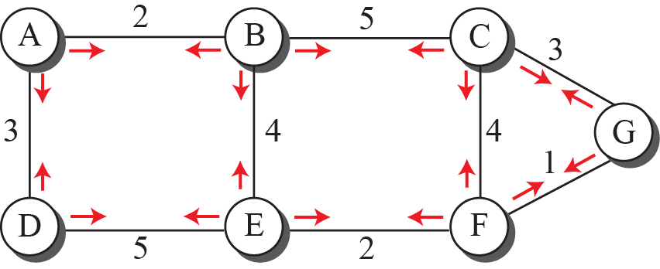
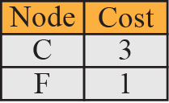
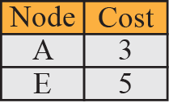
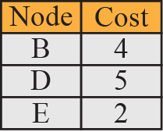
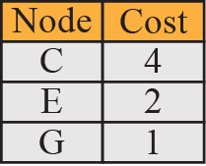
Example 2: Link State setup for a network

Slide 10
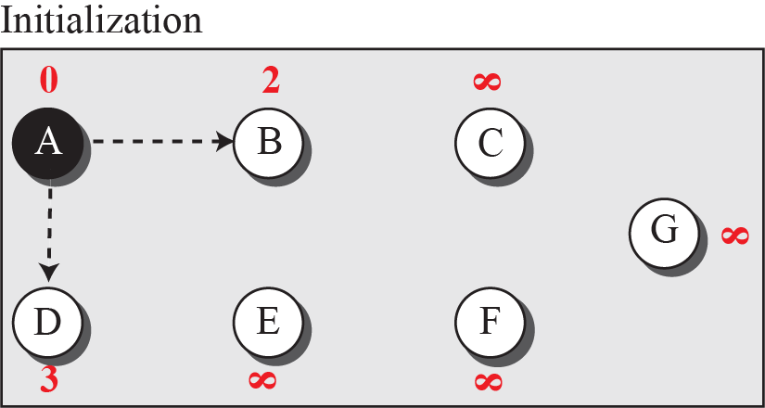

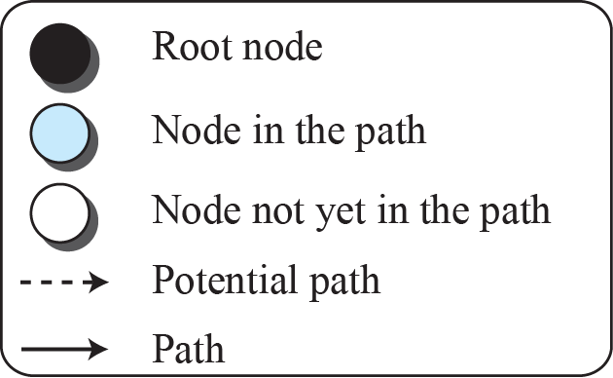
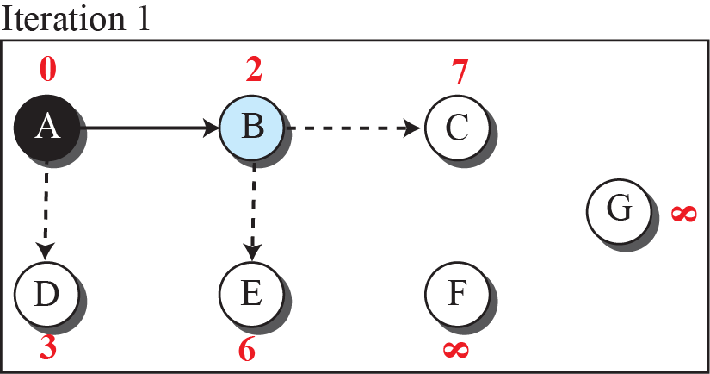
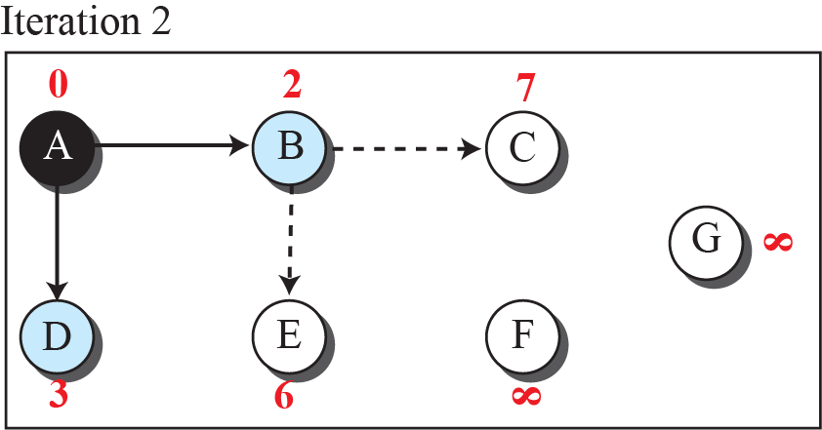
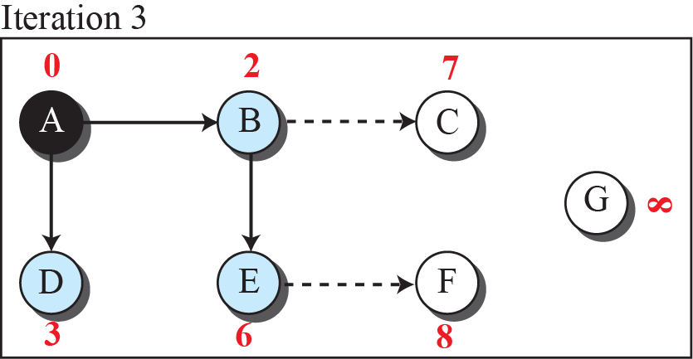
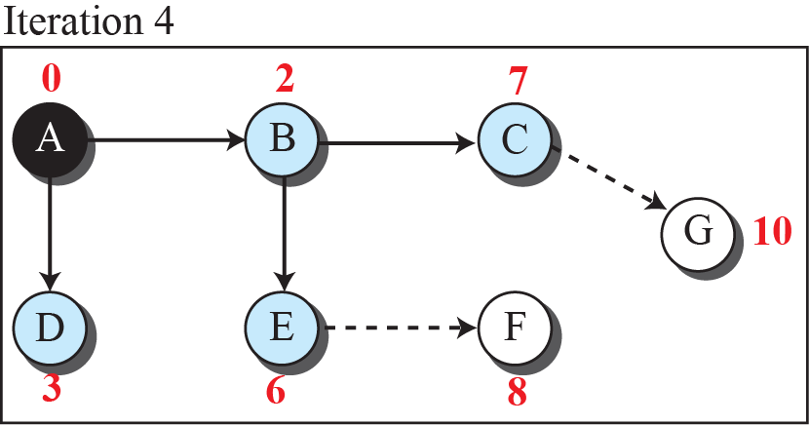
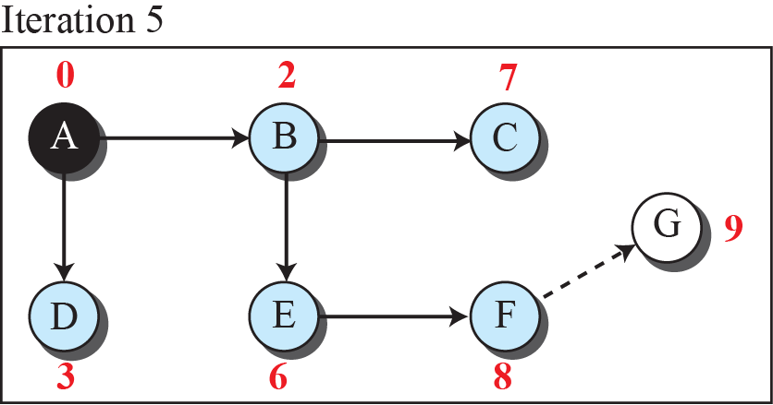
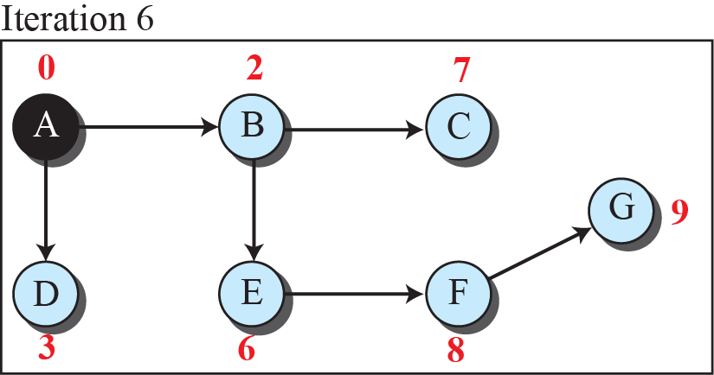
Example 3: Finding Least cost tree (Dijkstra Algorithm)

Slide 11
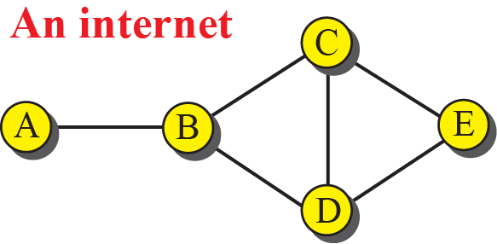
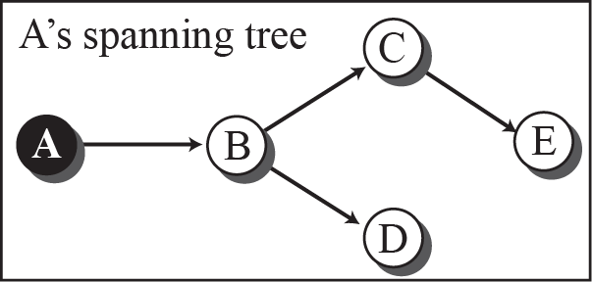
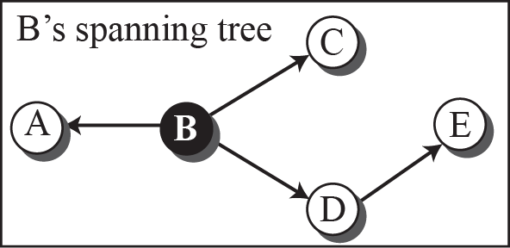
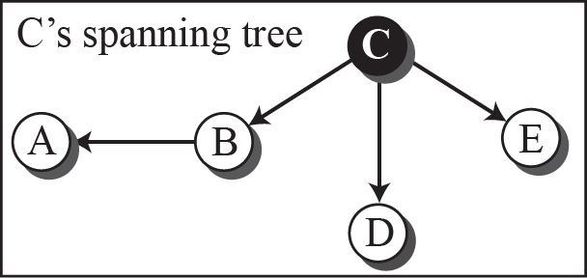
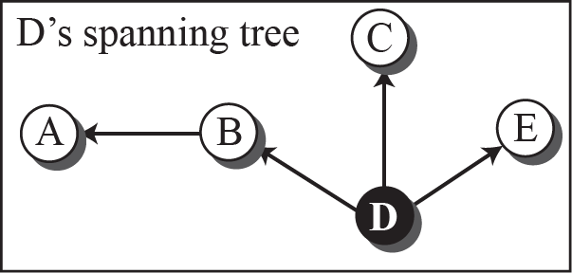
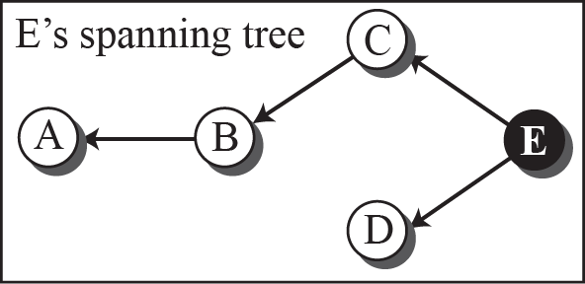
Example 4: Creating Spanning Tree

Slide 12
Unicast Routing
In unicast routing, a packet is routed, hop by hop, from its source to its destination by the help of forwarding tables.
The source host needs no forwarding table because it delivers its packet to the default router in its local network.
The destination host needs no forwarding table either because it receives the packet from its default router in its local network.
This means that only the routers that glue together the networks in the internet need forwarding tables.
Examples :
  Routing Information Protocol (RIP): distancee-vector algorithm
  Open Shortest Path First (OSPF): based on the link-state algorithm.

Slide 13
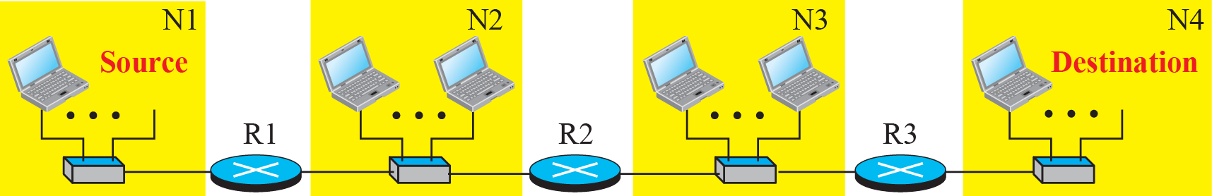
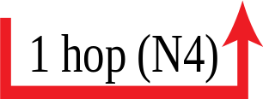

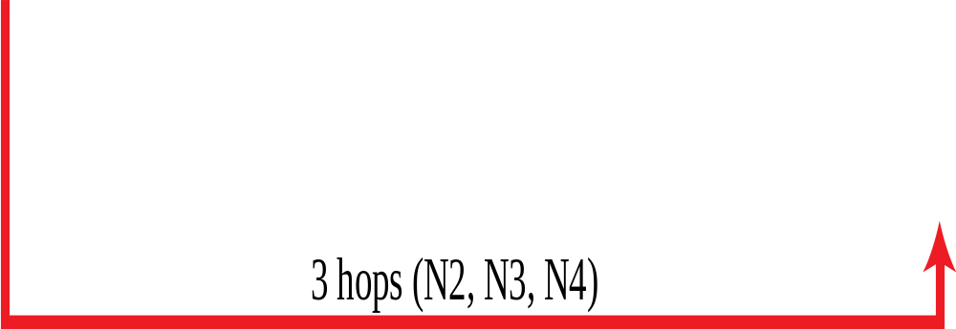
Routing Information Protocol (RIP)
The Routing Information Protocol (RIP) is one of the most widely used intra domain routing protocols based on the distance-vector routing algorithm.

Slide 14





    Hop Count and Message Format in RIP

Slide 15




Open Shortest Path First (OSPF) Protocol
Open Shortest Path First (OSPF) is also an intradomain routing protocol like RIP, but it is based on the link-state routing protocol. OSPF is an open protocol, which means that the specification is a public document.

Slide 16




Forwarding Table and Message Format in OSPF

Slide 17


Multicast Routing
In multicasting, there is one source and a group of destinations.
The relationship is one to many.
In this type of communication, the source address is a unicast address, but the destination address is a group address, a group of one or more destination networks in which there is at least one member of the group that is interested in receiving the multicast datagram.

Slide 18

Multicast Basics
Multicasting Needs:
multicast addressing,
collecting information about multicast groups,
multicast optimal trees.
We cannot include the addresses of all recipients in the packet.
The destination address of a packet, as described in the Internet Protocol (IP) should be only one.
For this reason, we need multicast addresses. A multicast address defines a group of recipients, not a single one. In other words, a multicast address is an identifier for a group.

Slide 19
Summary
In this section we have discussed the following:
Concept of Routing
RIP and OSPF protocols
Unicast and multicast routing
Notes:
1.#

Slide 20

Notes:
1.#

